Slide 1
Food Delivery Profitability Analysis
Garima Mahajan
Linkedin: https://www.linkedin.com/in/garima-mahajan997

Slide 2
Problem Statement
A food delivery service is facing challenges in achieving profitability across its operations. With a dataset of 1,000 food orders, the service seeks to understand the dynamics of its cost structure and profitability to identify strategic opportunities for improvement.
Detailed Cost Analysis: Identifying the major cost components associated with delivering food orders, including direct costs like delivery fees and indirect costs like discounts and payment processing fees.

Slide 3
Problem Statement
Strategic Recommendations for Improvement:Based on the cost and profitability analysis, identifying actionable strategies to reduce costs, adjust pricing, commission fees, and discount strategies to improve profitability. This includes finding a “sweet spot” for commission and discount percentages that ensures profitability across orders.
Impact Simulation of Proposed Strategies: Simulating the financial impact of the recommended strategies on profitability, using the dataset to forecast how adjustments in commission rates and discount strategies could potentially transform current losses into profits

Slide 4
Data Exploration
There are 1000 rows and 12 columns in the data. –
In our data we found there was around 18.5% missing data for the column Discount and Offers.
As 18.,5% is a very big number hence, instead of dropping the data we performed null imputation.
As the type of data is object we applied mode as a metric

Slide 5
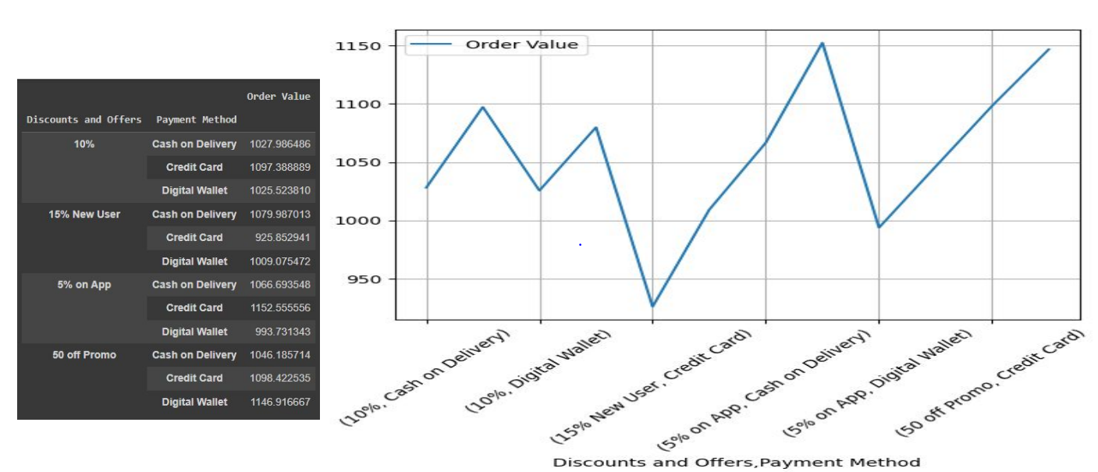
Order Value Distribution based on Payment Method / Discount Order
Effective Promotions: The combination of "15% New User, Credit Card" seems to be particularly effective in driving higher average order values. This suggests that targeted discounts for new users can be a powerful strategy.

Slide 6
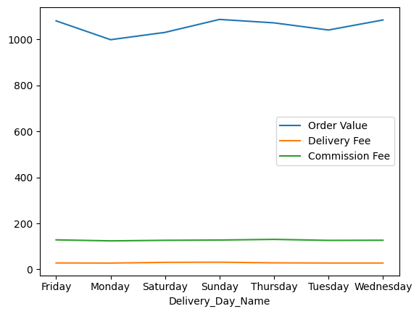
Impact of Day of the Week on Order Value and Fees
Order Value Trend: The order value fluctuates across the week, with the highest value on Sunday and the lowest on Monday.
Delivery Fee and Commission Fee: Both remain relatively constant throughout the week, with minimal variation.

Slide 7
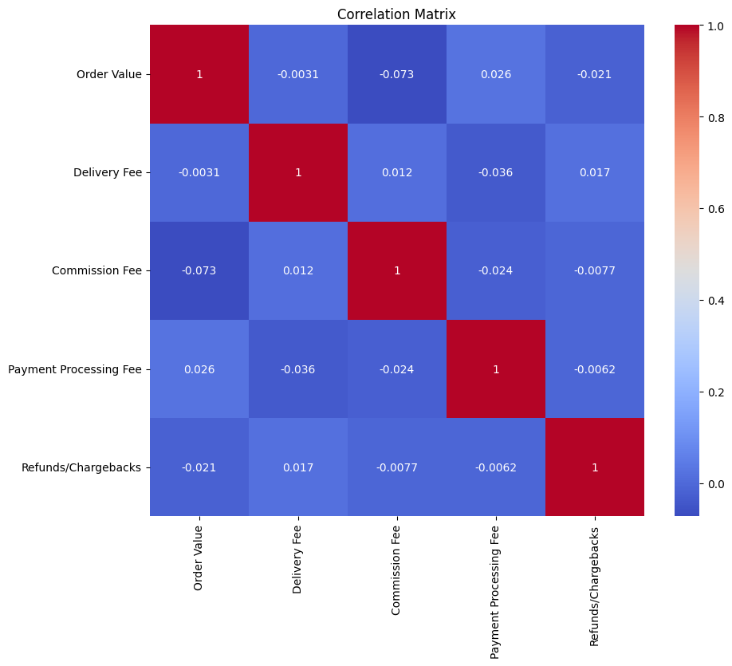
Correlation Analysis
Order Value: Has weak or negligible correlations with all other variables.
Delivery Fee: Has a slightly negative correlation with "Payment Processing Fee", indicating that as delivery fees increase, payment processing fees tend to decrease slightly.
Commission Fee: Has a weak negative correlation with "Payment Processing Fee" and "Refunds/Chargebacks".
Payment Processing Fee: Has weak negative correlations with "Delivery Fee", "Commission Fee", and "Refunds/Chargebacks".
Refunds/Chargebacks: Has a weak negative correlation with "Order Value" and a weak positive correlation with "Delivery Fee".

Slide 8
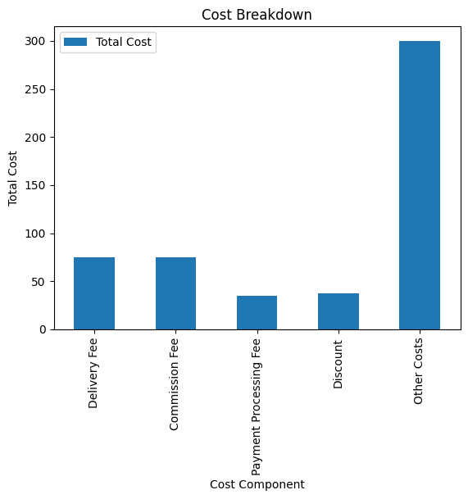
Key Cost Components
Dominant Cost Component: The "Other Costs" category has the highest total cost, indicating that it is the most significant contributor to the overall cost. This category might include various expenses such as packaging, handling, storage, or administrative overhead.
Delivery and Commission Fees: The "Delivery Fee" and "Commission Fee" components also contribute significantly to the total cost. This suggests that optimizing delivery operations and negotiating better commission rates could potentially reduce costs.
Payment Processing Fee and Discount: These components have relatively lower costs compared to others. While optimizing payment processing fees might yield some savings, the impact might be less significant.

Slide 9
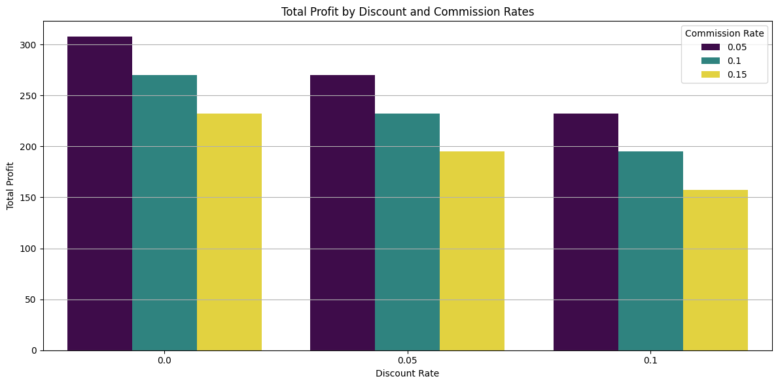
Simulated Total Profit by Discount and Commission Rates

Slide 10
Insights
Impact of Discount Rate: As the discount rate increases, the total profit generally decreases. This is because higher discounts reduce the revenue per unit sold, leading to lower overall profits.
Impact of Commission Rate: For a given discount rate, increasing the commission rate decreases the profit. This is because a higher commission rate reduces the net revenue per unit sold.
Trade-off between Discount and Commission: There's a trade-off between discounts and commissions. Increasing discounts can attract more customers but reduces the profit margin per customer. Increasing commissions can incentivize sales but reduces the overall profit.

Slide 11
Potential Strategies
Optimal Discount and Commission Rates: The chart can help identify the optimal combination of discount and commission rates that maximizes profit.This might involve a balance between attracting customers with discounts and maintaining a reasonable profit margin.
Customer Segmentation: Consider segmenting customers and offering targeted discounts to high-value customers or specific customer segments. This can help maximize revenue while minimizing the impact on overall profit.
Cost Optimization:Focus on reducing costs in areas such as operations, logistics, and marketing to offset the impact of discounts and commissions. Explore opportunities to negotiate better deals with suppliers and service providers.
Dynamic Pricing: Implement dynamic pricing strategies to adjust prices based on demand, competition, and other factors.This can help optimize revenue and profit.

Slide 12
THANK YOU!

